Slide 1
Brian Vineyard
Data Analysis Portfolio and Report Samples

Slide 2
Skills and Experience
Data Analytics and Management
Organize and manage data for secure reporting as a shared central resource
Build relational data models optimized for efficiency and fast performance
Tight integration of reporting to individual department goals and metrics
Power BI Admin experience to manage security and user access privileges
Data Visualization and Reporting
Set up reports specific to needs of managers and stakeholders
Design pivot tables and DAX formulas to model data based on Key Performance Indicators (KPI)
Visuals designed using best practices to clearly convey findings
User Research and Interaction
Provide users and stakeholders with written forms for gathering requirements/specs
Administrative and Logistical Support
Regular cadence of gathering/assessing feedback to improve usability/functionality
Continuous improvements to existing reports based on user needs
Marginal Functions
Skilled at presenting results in formal presentations to explain results and how to interact with reports
Technical documentation, help files, and knowledgebase content

Slide 3
Work Samples
Power BI
Sacramento International Airport Passengers (Aug 2025)
PacketFabric Network Service Outages (Jan 2021 – Mar 2023)
California Wildfires and Structure Damage (Oct 2017 – Oct 2024)
Jira Issue Project Summary (2023 YTD)
CalPers Local Contracting Agencies Funding Positions Report 2023
International Skating Union (ISU) Ice Skating Competitions
Adventure Works
Maven Market
Tableau
Netflix Movies and TV Shows
Excel
Superstore Financials

Slide 4
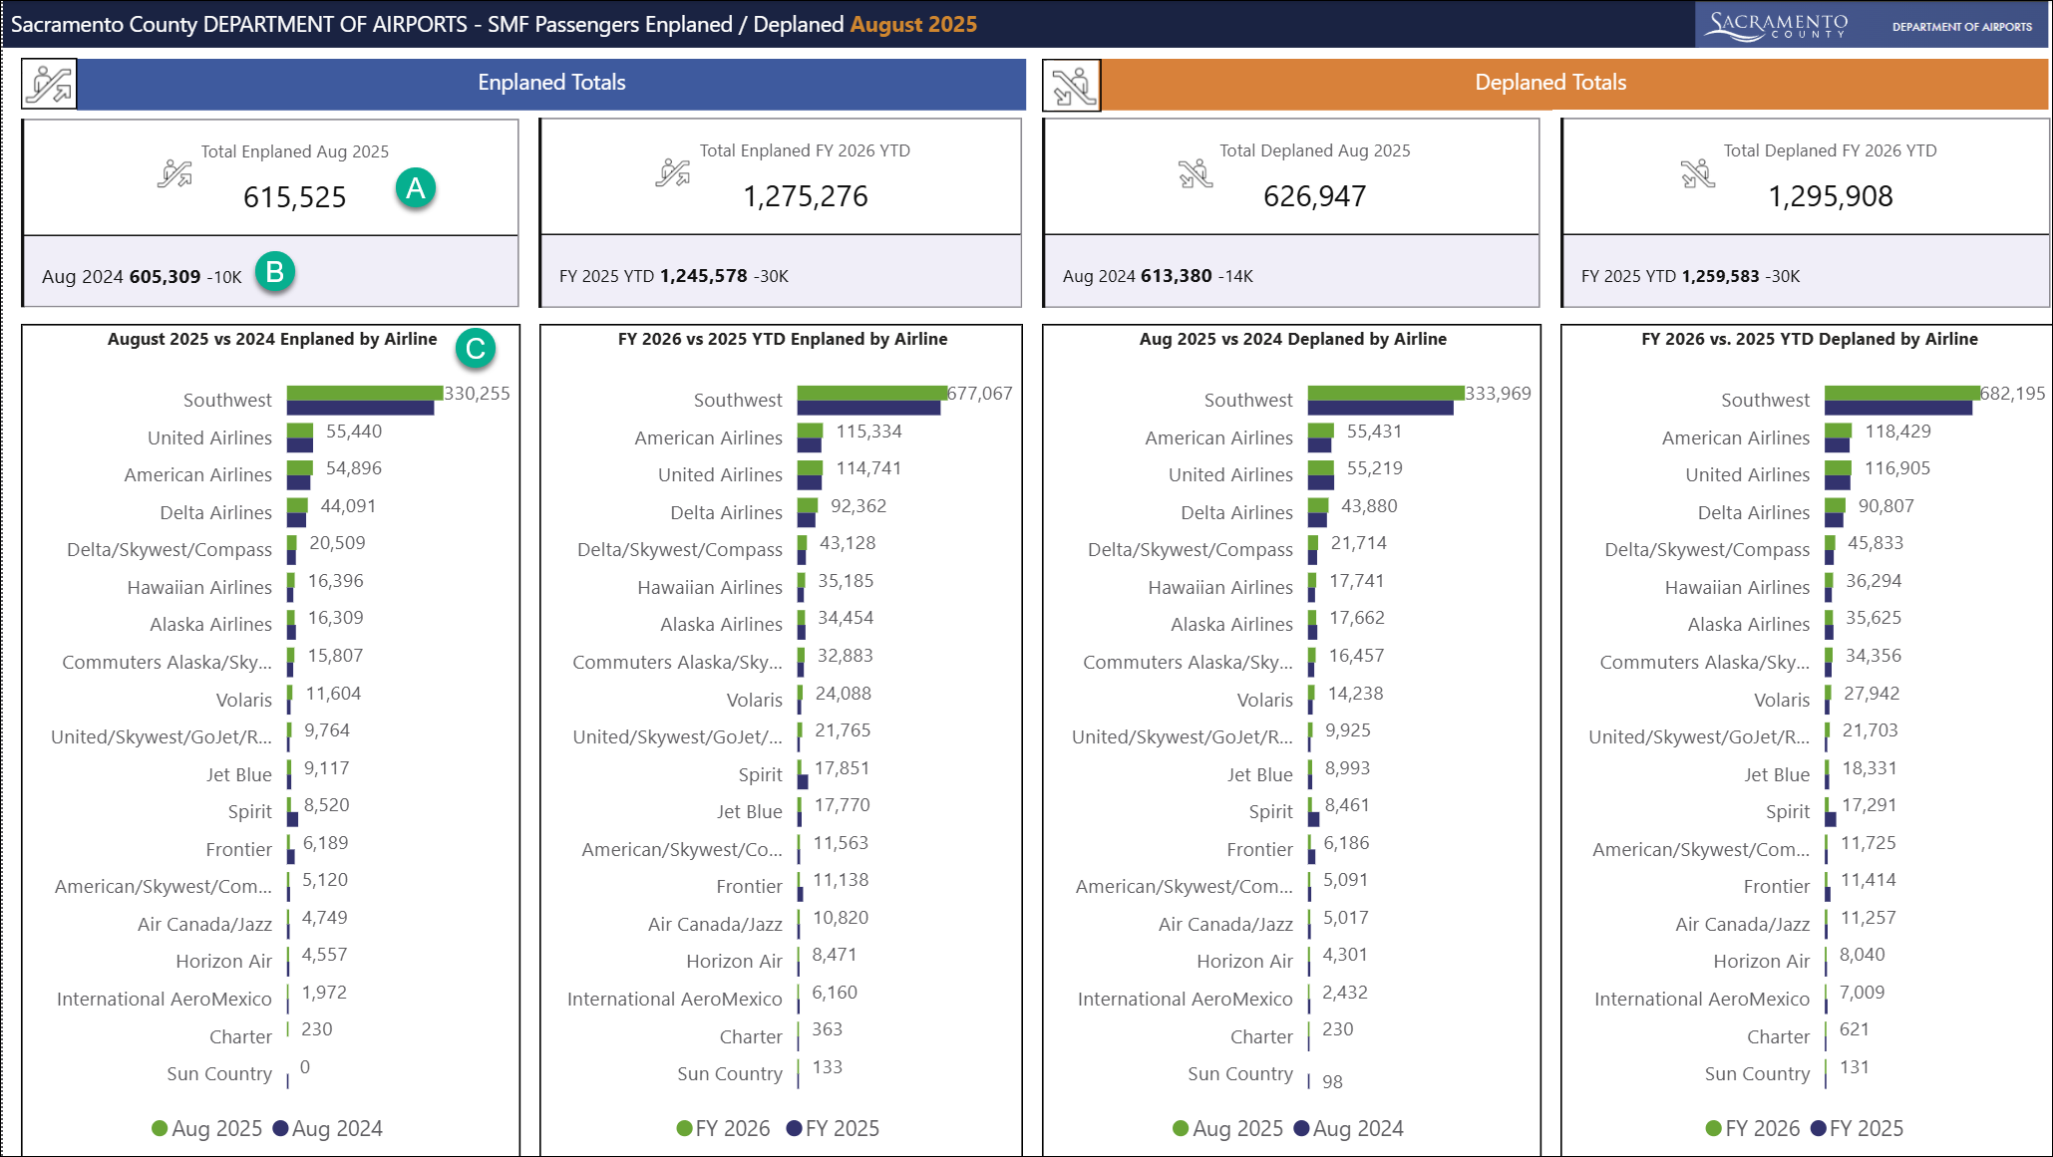
Sacramento County Dept of Airports SMF Passengers Enplaned / Deplaned (August 2025)
Passenger Analysis
Client: Sacramento County
Dept of Airports
Features:
Cards for Key Support Metrics:
Total Enplaned / Deplaned
Aug 2025
FY 2026 Year to Date
Bar Charts show totals by Airline for:
Aug 2025 vs Aug 2024
FY 2025 vs. FY 2024
Report Features:
A: New Card Visual
B: Reference Card
C: Clustered Bar Chart
Colors match Sac County Airport report branding.

Slide 5
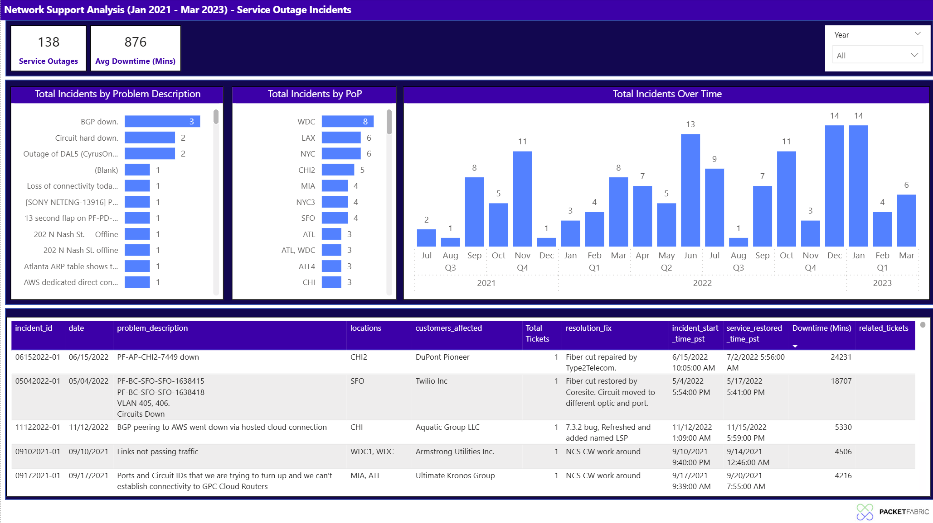
Network Support Analysis – Service Outage Incidents Report in Power BI
Analysis of Network
Service Outage Incidents
Company: PacketFabric
Features:
Cards for Key Support Metrics:
Total Incidents
Avg Downtime (in minutes)
Slicer for Year
Bar Charts show totals:
by Problem Description
By Point-of-Presence (PoP)
Column Chart shows:
Over Time (with date hierarchy for drilldown)
Table shows incident details
Colors match PacketFabric
Branding

Slide 6
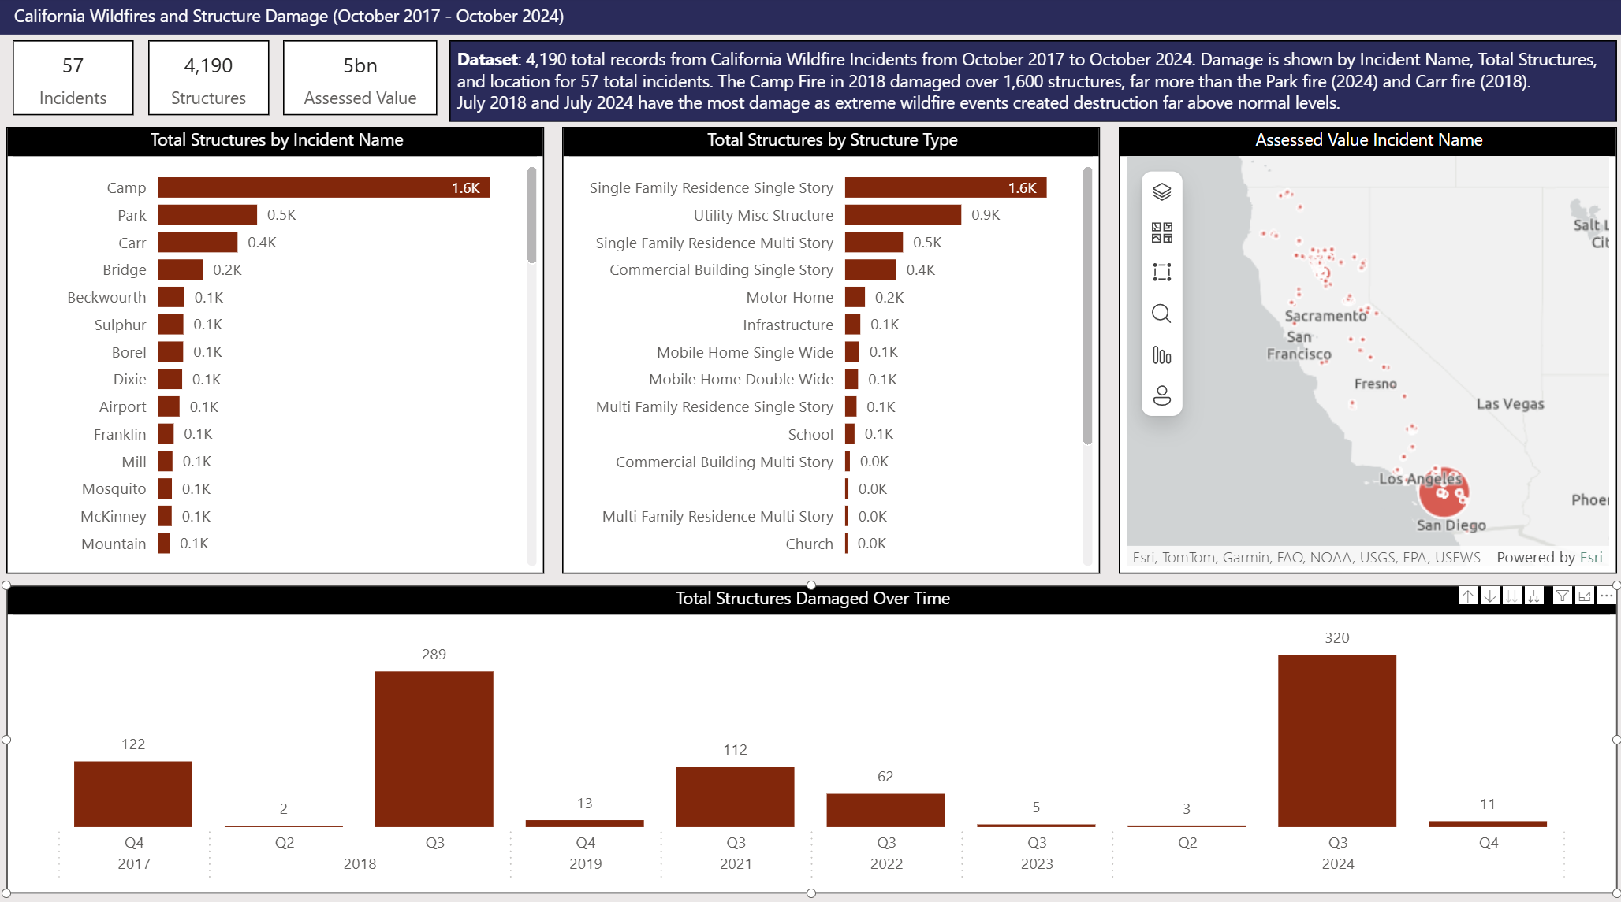
California Wildfires and Structure Damage – (Oct 2017 – Oct 2024) in Power BI
Analysis of California Wildfires and Structure
Damage (Oct 2017 – Oct 2024)
Dataset: 4,190 records
Features:
Cards for Key Support Metrics:
Total Incidents
Total Structures
Total Assessed Value
Bar Charts show total structures lost:
by Incident Name
by Structure Type
Column Chart shows data:
Over Time (with date hierarchy for drilldown)
ArcGIS Map shows fire locations

Slide 7
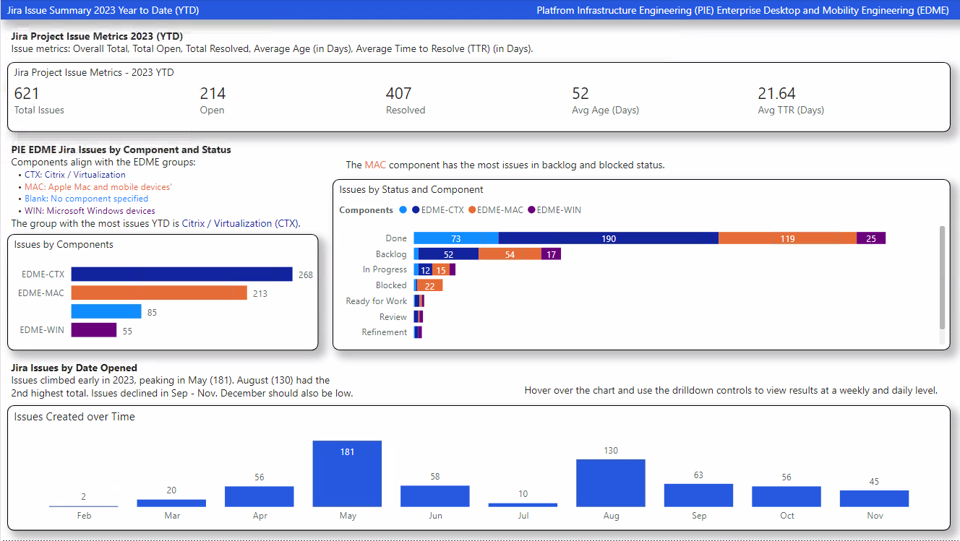
Jira Project Summary - Analysis of Project Issues for OneMain Financial
Analysis of Jira Issues
Dataset: Jira issues for 2023 Year to Date pulled from Snowflake
Features:
Cards for Key Support Metrics:
Total Issues
Open Issues
Resolved
Avg Age (Days)
Avg Time to Resolve
Bar Charts show total issues:
by Component
by Status and Component
Column Chart shows data:
Over Time (with date hierarchy for drilldown)
Text Boxes provide help to users on findings and how to use drilldown controls.

Slide 8
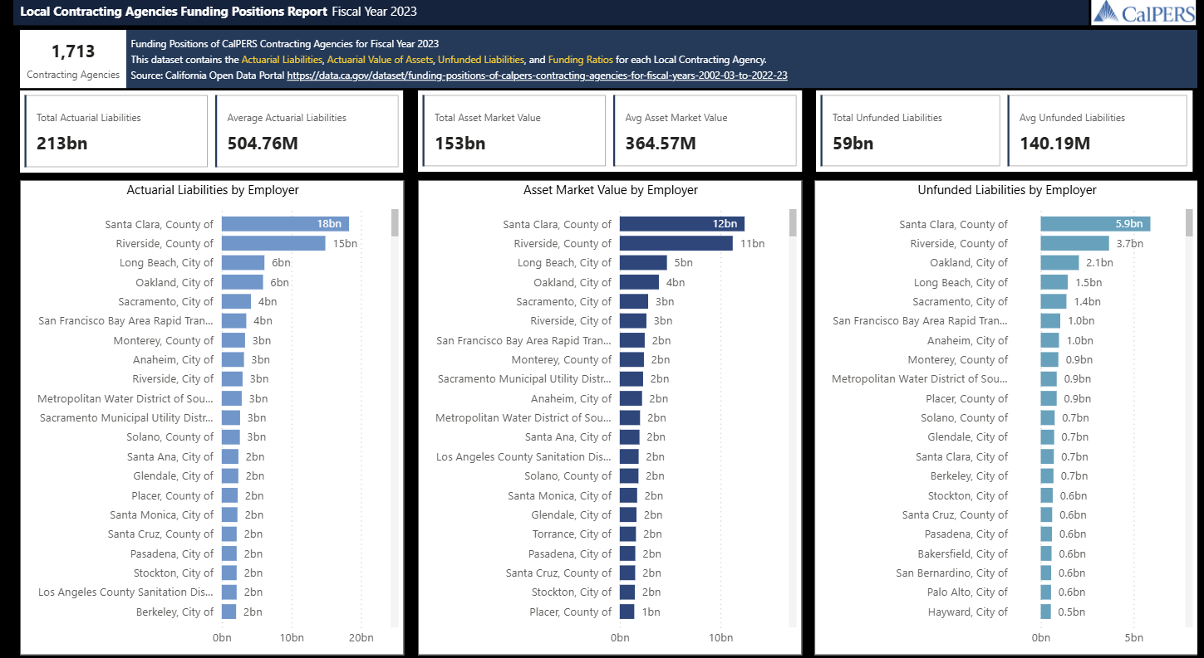
CalPers Local Contracting Agency Funding (FY 2023)
Analysis of Calpers Contracting Agency Funding
Dataset: Funding positions of CalPers Contracting Agencies for FY 2023
Features:
Cards for Key Metrics:
Total and Average:
Actuarial Liabilities
Asset Market Values
Unfunded Liabilities
Bar Charts show totals by Employer for:
Actuarial Liabilities
Asset Market Value
Unfunded Liabilities

Slide 9
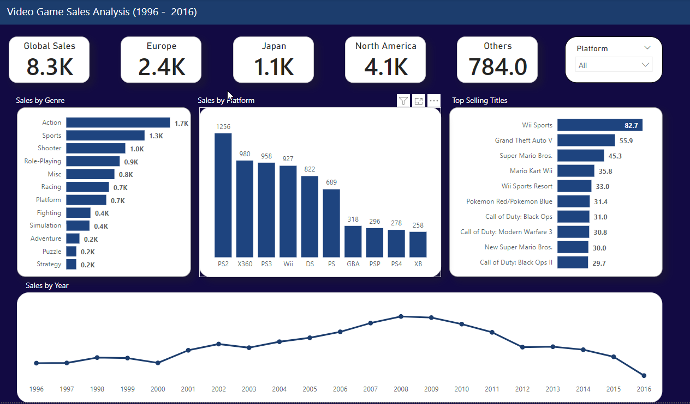
Dataset: Video Game Sales Analysis with data of top selling titles by region for 20 year span: 1996 – 2016

Slide 10
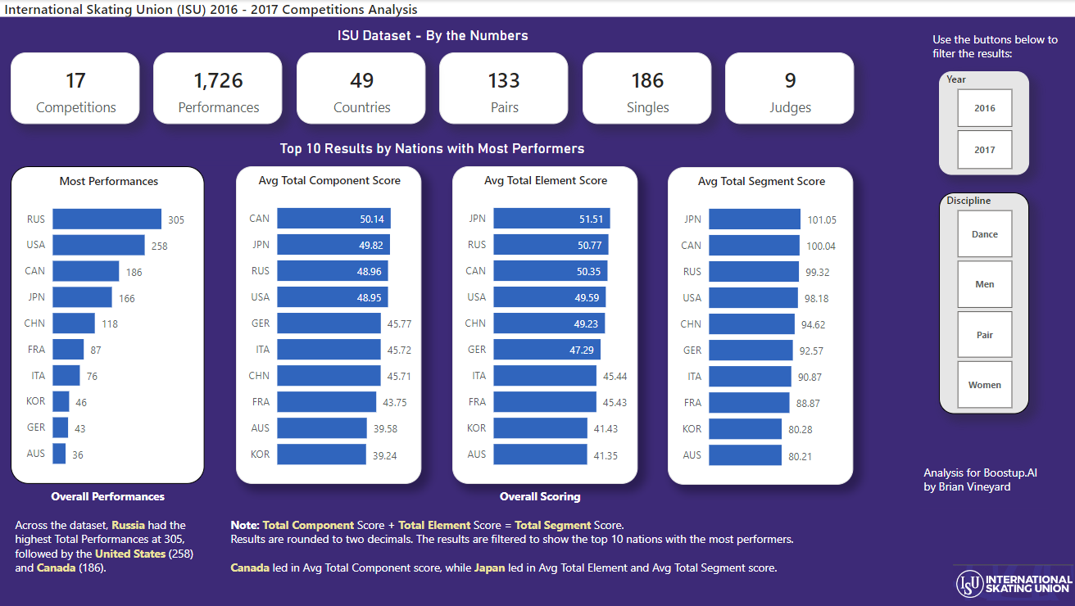
International Skating Union (ISU) Ice Skating Competition Analysis
Dataset: ISU Skating Competition Analysis from BuzzFeed News with data from Oct 2016 – Dec 2017

Slide 11
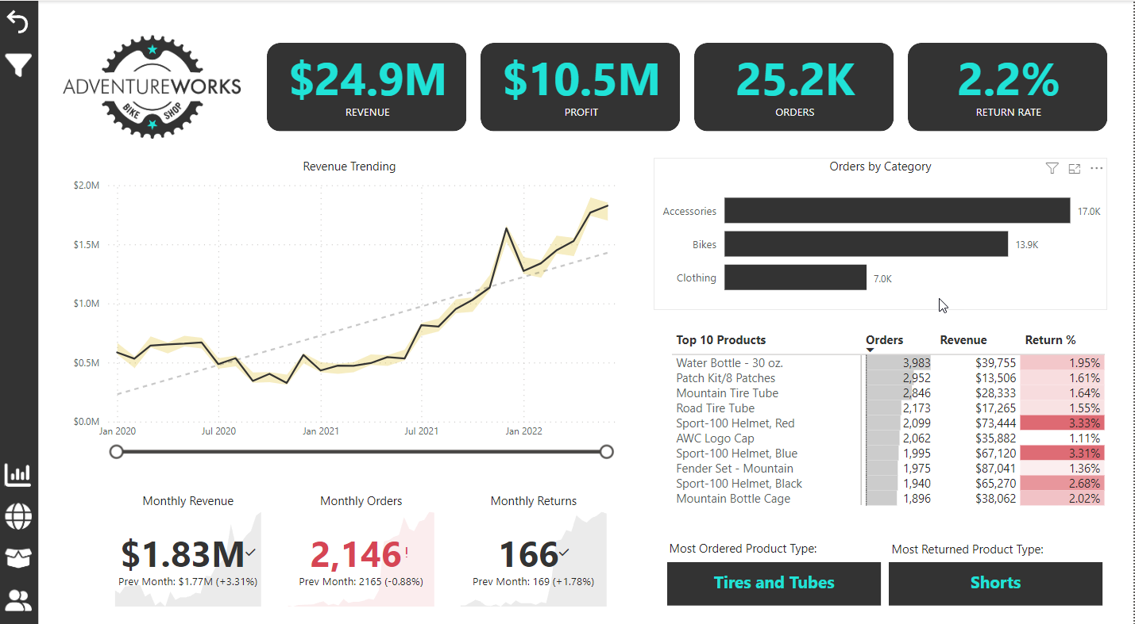
Dataset: Adventure Works for SQL Server 2022 with sample data for almost 58,000 sales records

Slide 12
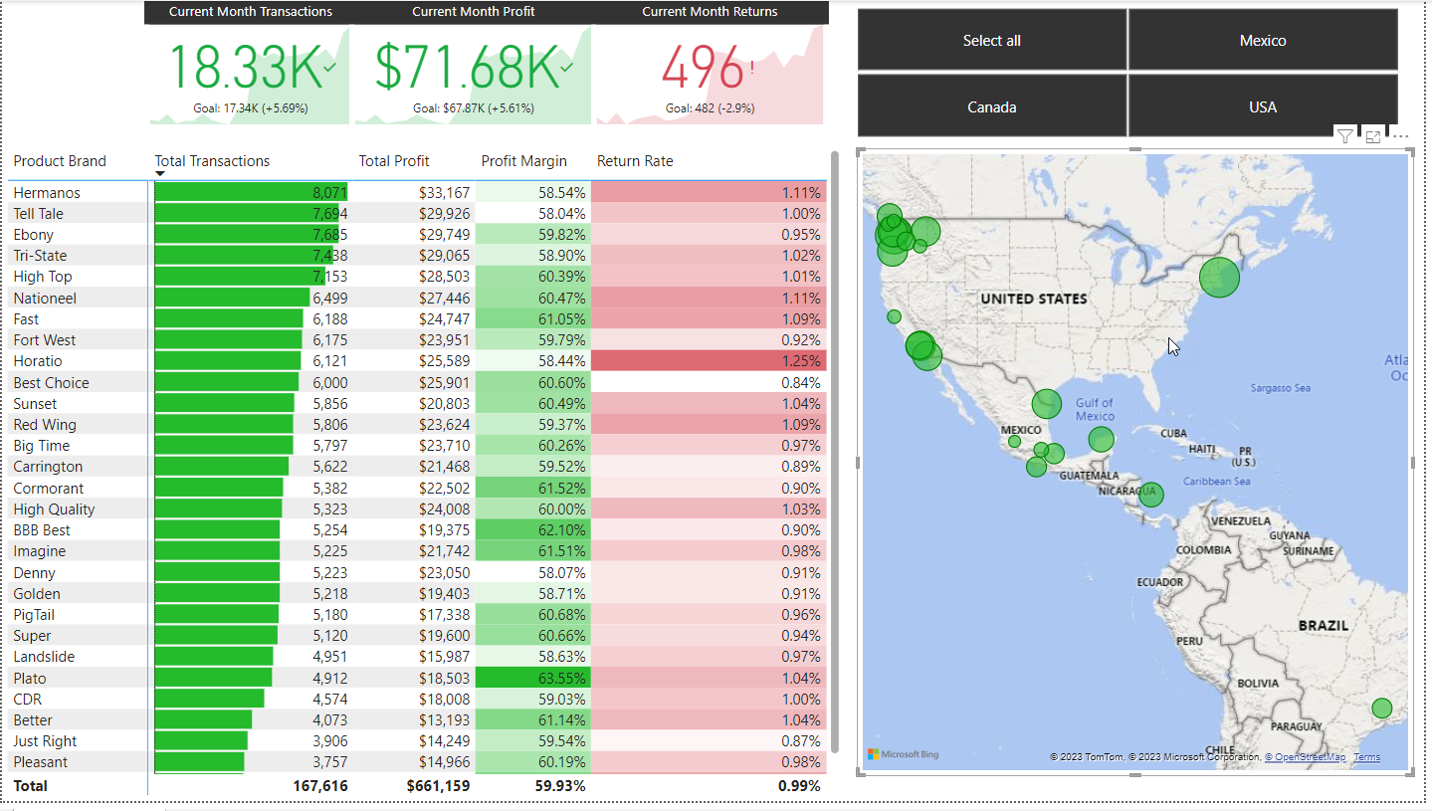
Power BI: Maven Market Financial Report

Slide 13
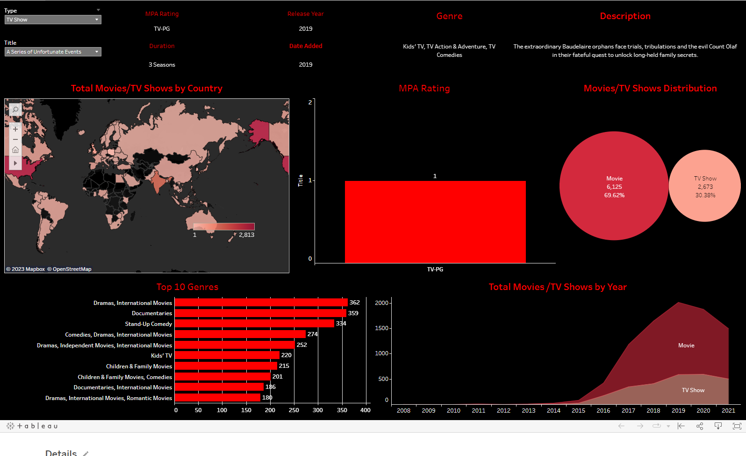
Tableau: Netflix Data
This dashboard is
available on Tableau
Public at https://public.tableau.com/app/profile/brian.vineyard/viz/netflix_16879639661060/Netflix
View Netflix
Movies and TV Shows
and select countries
using the world map to
see the most popular results in that region.

Slide 14
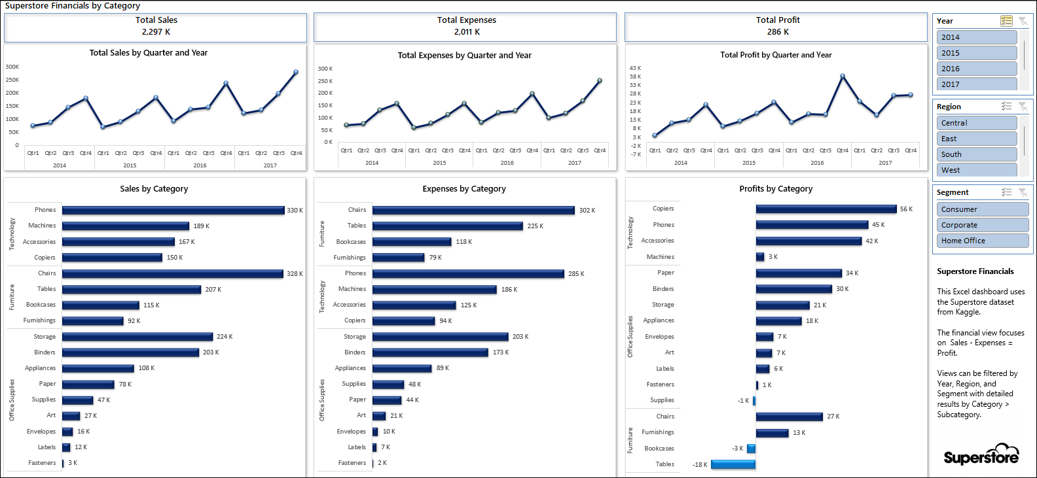
Excel: Superstore Financials
Note: Modeling based on Category / Subcategory shows the most and least profitable products.

Slide 15
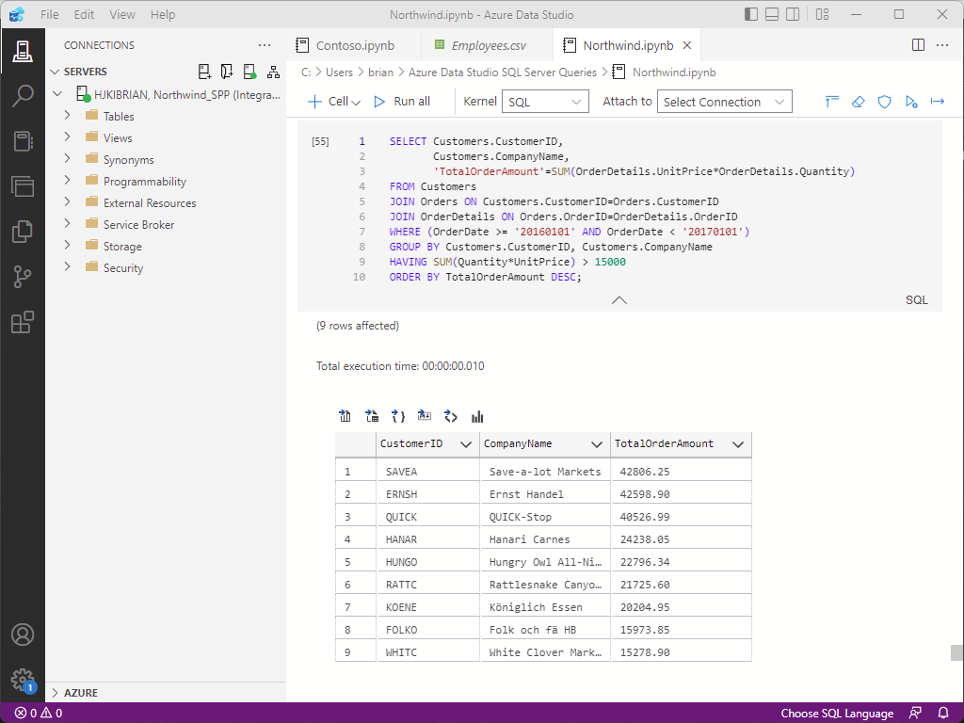
SQL: SQL Server, SSMS, Azure Data Studio
This query is in an Azure Data Studio notebook connected to the Northwind database in SQL Server.
This returns the CustomerID,
CompanyName and TotalOrderAmount
for orders with totals greater than $15,000
in 2016.
Results can be saved as a .CSV file, or
produced as visual charts.
Azure Data Studio is a free tool and with
Python and Jupyter Notebooks are a great way to do analysis at no cost.
These tools also handle large datasets.

Slide 16
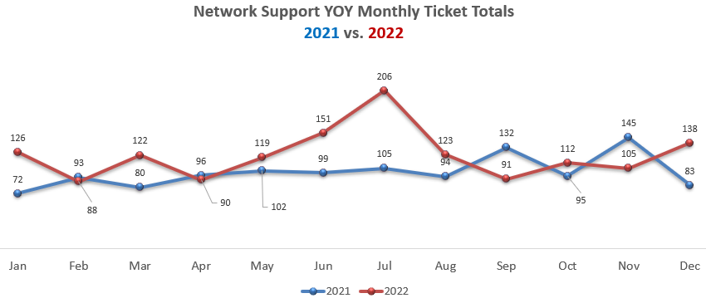
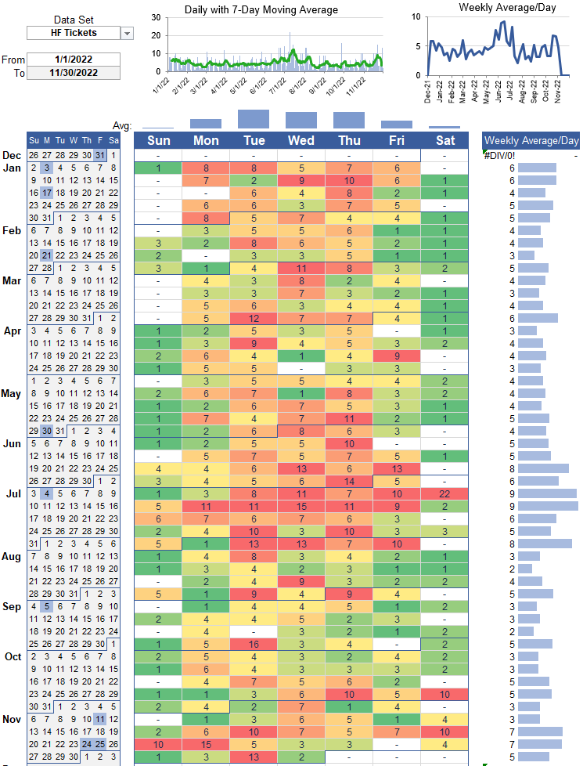
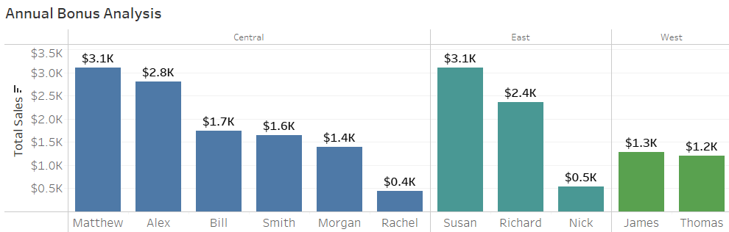
Report Visualizations
Line chart showing results over time
Calendar heat map showing daily case volume, company holidays, daily & weekly averages.
Bar chart showing categorical data comparison

Slide 17
Dataset: Jira IT Service Desk Analysis with sample data for over 1,500 issues from Dec 2018 – Sep 2020

